Slide 1

Linux Fundamentals VERSION 4 April-2023 Part 2 Eng Ali Mohammad. Bani Bakkar

Slide 2
What is the shell?
The shell is a program that takes commands from user’s keyboard and passes them to the operating system to execute.
• Many shell programs are available for Linux:
• bash, sh, csh, tcsh, ksh, zsh, …
• we will use bash, but other shells are conceptually similar

Slide 3
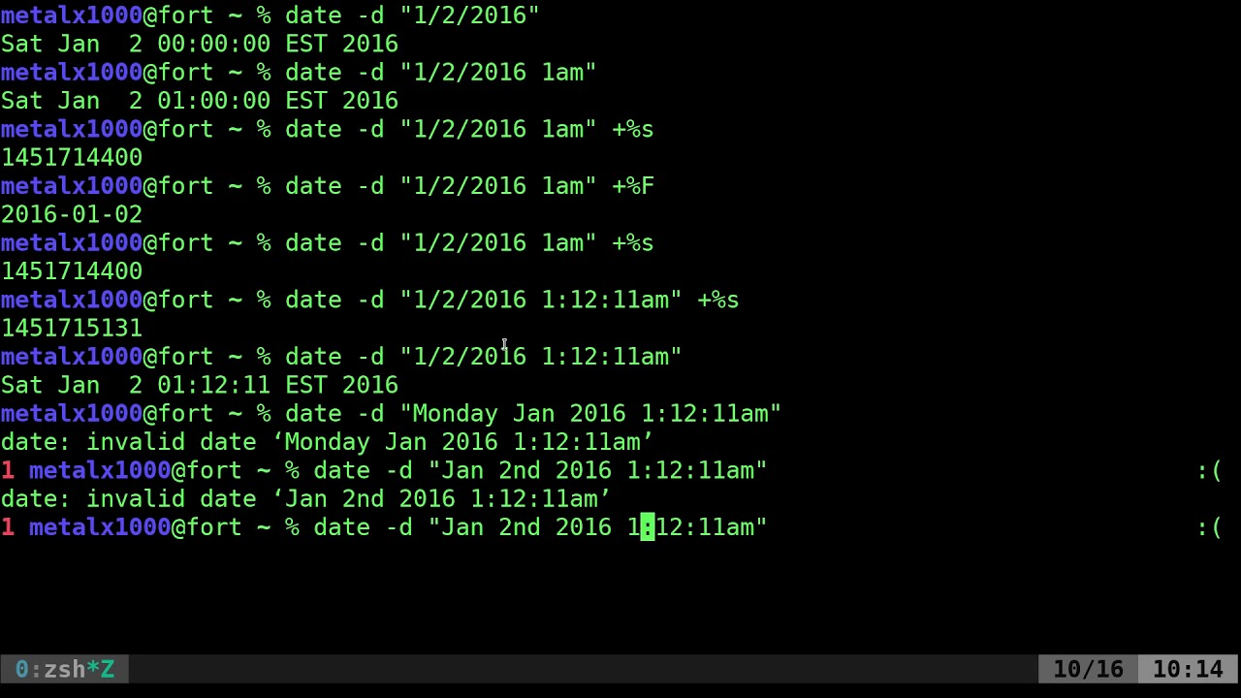
What is the shell?

Slide 4
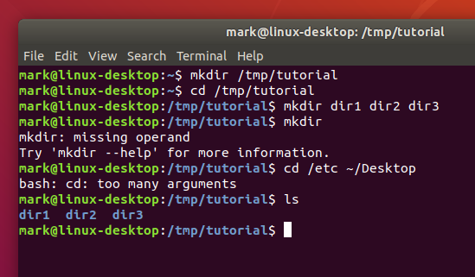
What is Terminal?
Terminal is a program that opens in a window and lets users interact with the shell.

Slide 5
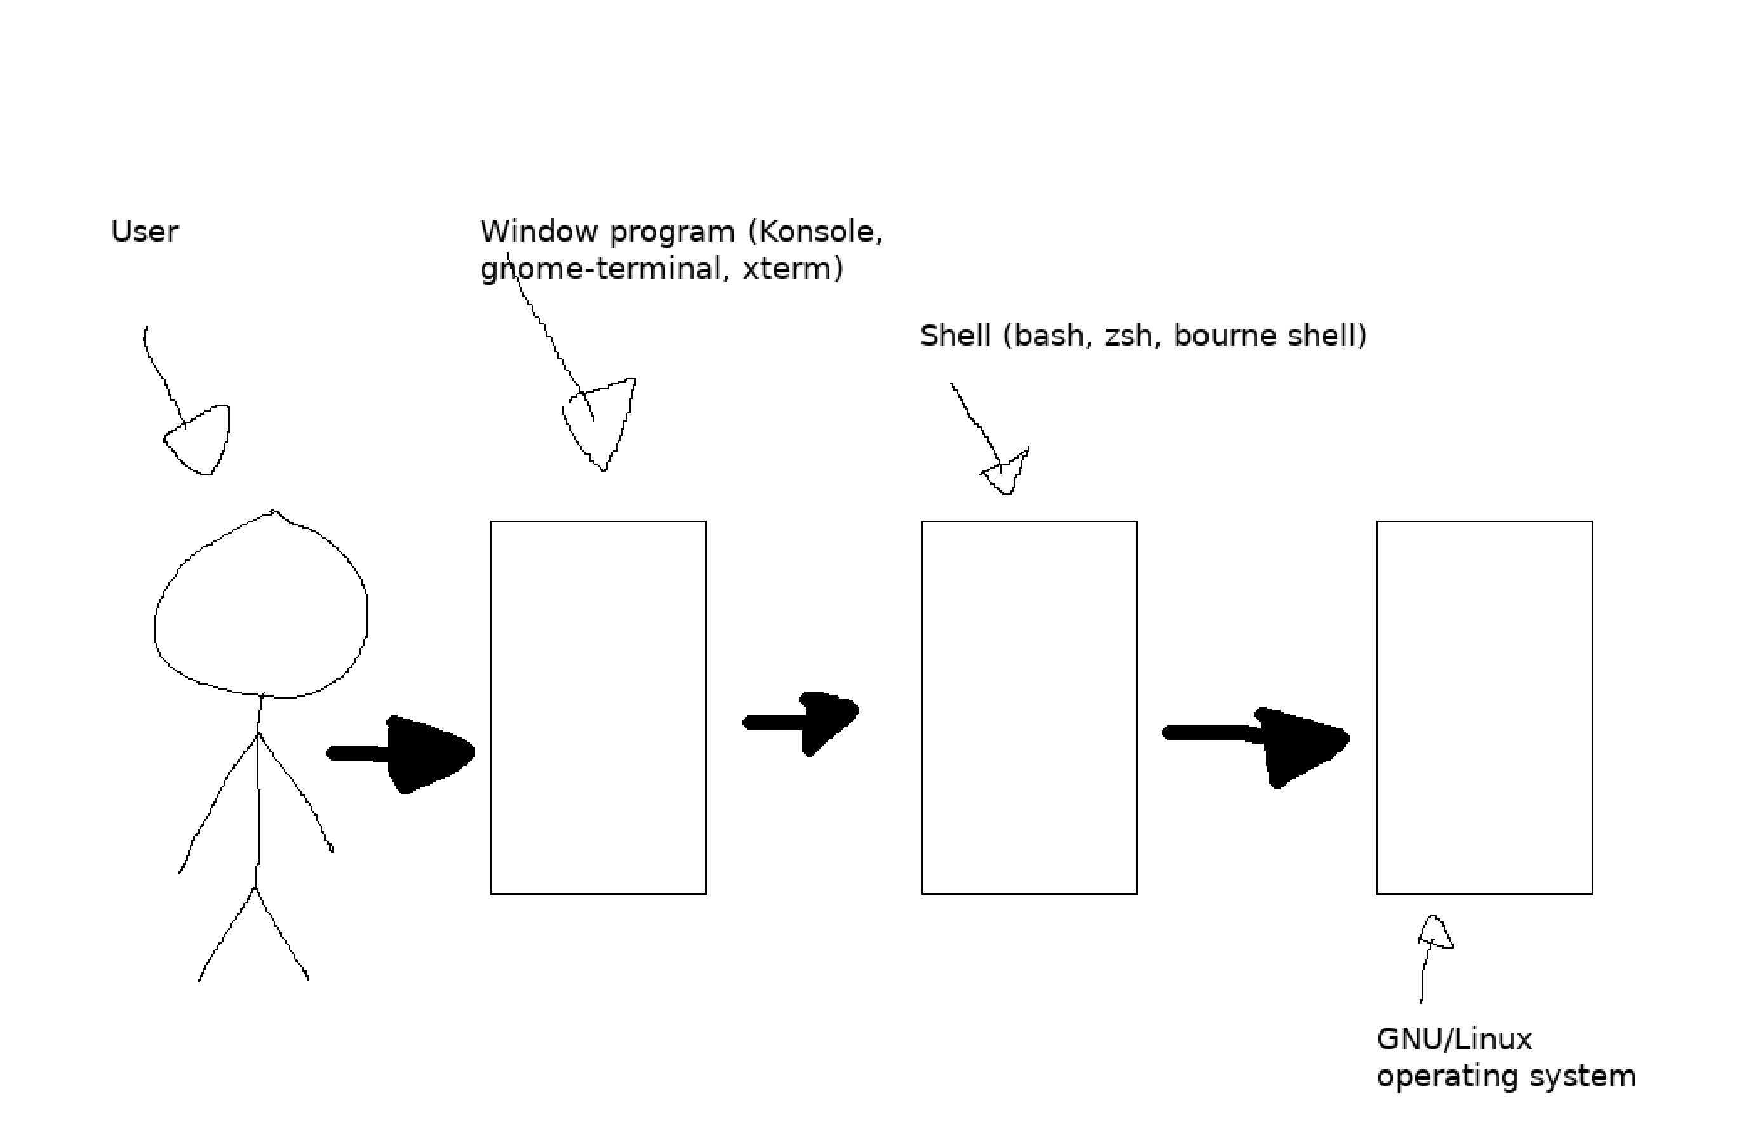

Slide 6
Ls Command
Ls :You can list the contents of a directory with ls.
ls –a : A frequently used option with ls is -a to show all files (including hidden files)
the hidden files. When a file name on a Linux file system starts with a dot.
ls –l :Typing just ls gives you a
list of files in the directory. Typing ls -l gives you a
long listing.
ls –lh : It shows the numbers (file sizes) in a more human readable format.
Ls –lr :
Ls –lt :
Ls ~
Ls .

Slide 7
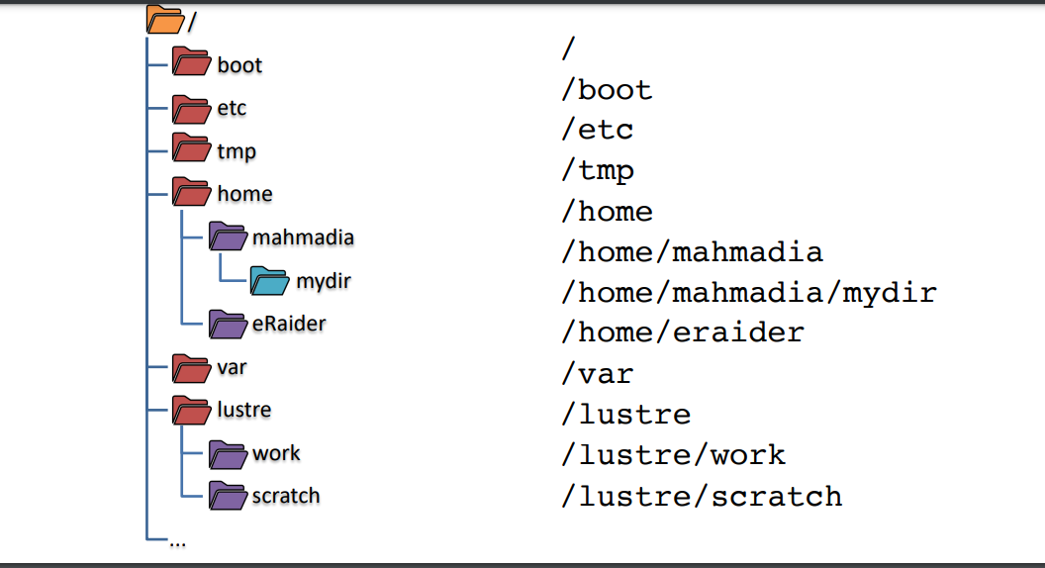
Working With Directories

Slide 8
Working With Directories (1)
Pwd (Print Working Directory):The tool displays your current directory.
Cd : You can change your current directory with the cd command (Change Directory).
cd ~:The cd is also a shortcut to get back into your home directory. Typing cd ~ has the same effect.

Slide 9
Working With Directories (2)
cd .. : To go to the parent directory (the one just above your current directory in the directory tree), type cd .. .
cd ../../
To stay in the current directory, type cd .
cd - : to go to the previous directory.

Slide 10
Try
Ls --help
Init – help??
Cal –help
Date –help
su
Passwd
Whoami
Which
History [!number of line]
History –c (clear)
Cat .bash_history
cd ~ali
Dir --help
Nautilus :Nautilus file manager for the GENOME desktop system. similar to windows explorer.
hostname

Slide 11
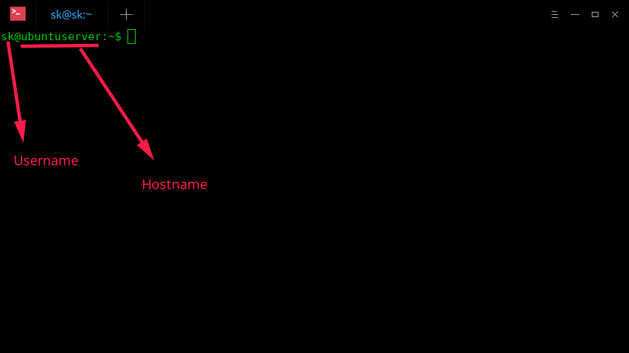

Slide 12
apt update vs. apt upgrade: A Comparison
apt update command might seem like the obvious go-to option to update your packages on Linux, it’s not entirely the case. The update command gives you an idea about the available updates, but it does not download or install the updates within your distro.
apt upgrade command downloads and installs available updates on your machine in one go. Your Linux system has an available cache of software (packages), which contains the necessary metadata related to those packages. The metadata includes information pertaining to the version, repository, dependency, and other relevant package details.
If you don’t use the update command, you won’t refresh the cache, which would not give you a clue about the available package updates.

Slide 13
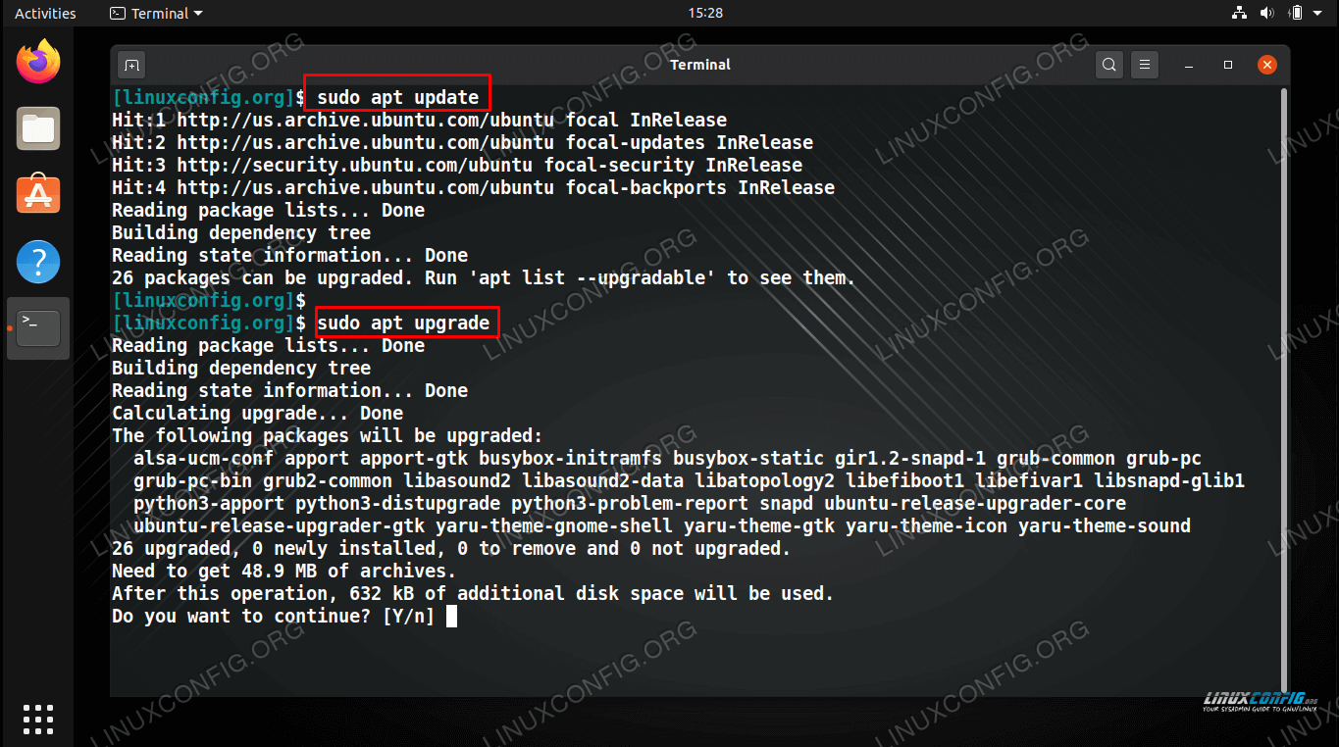

Slide 14
Apt update
Apt upgrade
Apt install package_name
Apt remove package_name
Apt remove –purge package_name //configuration
Dpkg –I package_name
Example
Apt-cache search apache2
Apt show apache2
Apt install apache2

Slide 15
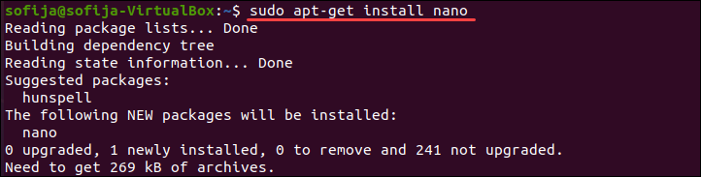

Slide 16
help
Man ls
Ls -- help
Whatis ls
Apropos : The apropos command helps users find any command using its man pages.
Which ls
Locate passwd //updated
Find location –name filename

Slide 17
Absolute and Relative Paths
An absolute path is defined as specifying the location of a file or directory from the root directory(/).
Relative path is defined as the path related to the present working directly(pwd).

Slide 18
Absolute and Relative Paths Example
current directory /home/ali. From within this
directory, you have to type cd /home instead of cd home to go to the /home directory.
$ pwd
/home/ali
$ cd home
bash: cd: home: No such file or directory
$ cd /home
$ pwd
/home
When inside /home, you have to type cd ali instead of cd /ali to enter the subdirectory
ali of the current directory /home.
$ pwd
/home
$ cd /ali
bash: cd: /ali: No such file or directory
$ cd ali
$ pwd
/home/ali

Slide 19
Path Completion
The tab key can help you in typing a path without errors.
Typing cd /et followed by the tab
key will expand the command line to cd /etc/. When typing cd /Et followed by the tab key,
nothing will happen because you typed the wrong path (upper case E).

Slide 20
Mkdir Command
Mkdir : to create a directory.
mkdir –p : create the directory and, if required, all parent directories.
mkdir -p fruits/apples
mkdir fruits cars

Slide 21
Rmdir Command
Rmdir : When a directory is empty, you can use rmdir to remove the directory.
rmdir –p :remove directory and its ancestors
rm –r : you can use rmdir to recursively remove directories.
rm –rf: you can also use rmdir to recursively force remove directories with out interaction.
To delete folders with files in them, we'll use the more
generic rm command which deletes files and folders,
using the -rf options:

Slide 22
Working with Files
File
touch
rm
cp
mv
rename.

Slide 23
Working with Files Notes (1)
all files are case sensitive (This means that FILE1 is different from file1, and /etc/hosts is different from /etc/Hosts) .
everything is a file (A directory is a special kind of file, but it is still a (case sensitive!) file.
Each terminal window (for example /dev/pts/4), any hard disk or partition (for example /dev/sdb1) and any process are all represented somewhere in the file system as a file.

Slide 24
Working with Files Notes (2)
File : The file utility determines the file type. Linux does not use extensions to determine the file type.
$file filename
The command line does not care whether a file ends in .txt or .pdf. As a system administrator, you should use the file command to determine the file type.

Slide 25
Touch Command
Touch Touch command is a Linux command is mainly used to create empty files, and change timestamps of files or folders. The timestamp information of files consists of three attributes – access time, modification time, and change time.
touch –t : set access and modification time of a file to a particular date by using t option followed by datetime.
Touch file1 file2 file3
Touch file 5 (does it work?)(the solution)
touch file_name{1..3}.txt
touch -t 201903081047.30 file_name.txt

Slide 26
Rm command
Rm : remove forever : The rm command in Linux OS is used to remove files and directories from the command line.
rm -i will ask before deleting each file.
rm -r will recursively delete a directory and all its contents .
rm -f will forcibly delete files without askingrm testfile
rm ~/Documents/testfile
rm testfile1 testfile2 testfile3
rm -v -i testfile
rm -v -f testfile
rm -v -r test_directory
sudo rm -v *
rm -v *.txt
sudo rm -v -d test_dircetory1 / Remove Empty Directories
rm -v -r /
rm -v -r --no-preserve-root /
rm -v user*
rm -v sample[1234].list

Slide 27
Cp Command
copy one file :To copy a file, use cp with a source and a target argument.
cp file1.txt file2.txt
cp file42 file42.copy
copy to another directory : the source files are copied to that target directory.
cp a.txt dir42
cp –r:To copy complete directories, use cp -r (the -r option forces recursive copying of all files in all subdirectories).
cp -r dir42/ dir33
copy multiple files to directory You can also use cp to copy multiple files into a directory. In this case, the last argument must be a directory.
cp a b.txt cc dir42/
cp –I To prevent cp from overwriting existing files, use the -i (for interactive) option.
cp -i a.txt file42
cp -r logs1 logs2

Slide 28
Mv Command
rename files with mv : Use mv to rename a file or to move the file to another directory.
rename directories with mv :The same mv command can be used to rename directories.
mv –i The mv also has a -i switch similar to cp and rm.

Slide 29
Useful commands
Reboot
Exit
shutdown

Slide 30
date command
displays and sets the system date and time. This command also allows users to print the time in different formats and calculate future and past dates.
date [option]... [+format]
Date
date -d "2022-11-22 09:10:15“
date +"Year: %Y, Month: %m, Day: %d“
date "+DATE: %D%nTIME: %T“ (try this format)

Slide 31
Set or Change Date in Linux
date --set="20100513 05:30“
date --date="4 day“
Display Last Modified Timestamp of a Date File
date -r /etc/hosts

Slide 32
Which command
The which command allows users to search the list of paths in the $PATH environment variable and outputs the full path of the command specified as an argument.
which -a touch
which ls mount sort

Slide 33
Cal command
cal command is a calendar command in Linux which is used to see the calendar of a specific month or a whole year.
cal [ [ month ] year]
Cal
cal –y
cal 08 2000
cal 2018 | more

Slide 34
Install updates via apt-get command line
apt-get update : First, you use the update option to resynchronize the package index files from their sources on Ubuntu Linux via the Internet.
-sudo apt-get update
-or sudo apt update
apt-get upgrade : Second, you use the upgrade option to install the newest versions of all packages currently installed on the Ubuntu system. In other words, get security updates for your machine.
- sudo apt-get upgrade
- or sudo apt upgrade
sudo apt-get install package-name : Install is followed by one or more packages desired for installation. If package is already installed it will try to update to latest version.
- sudo apt-get install foo

Slide 35
Man command
man command in Linux is used to display the user manual of any command that we can run on the terminal.
It provides a detailed view of the command which includes NAME, SYNOPSIS, DESCRIPTION, OPTIONS, EXIT STATUS, RETURN VALUES, ERRORS, FILES, VERSIONS, EXAMPLES, AUTHORS and SEE ALSO.
$man [OPTION]... [COMMAND NAME]...
man printf

Slide 36
Man command cont.
$man date
/(search for word in the man pages)(n/N to transfer among words,g/G first and last page)
Man is divided in 9 chapters (1: program or shell commands,5:configuration ,8:command belongs to root)
$man 1 passwd
man 5 passwd
$man 9 passwd
$man cat

Slide 37
Man command cont.
Man print (no command found)
Man –k “print files”
Man –K “print files” all command man page
Man –K time|grep 1
Note : you can try info command , what is the difference?

Slide 38
Working with File Contents
Head
Tail
cat
tac
more
less

Slide 39
Head
Head : You can use head to display the first ten lines of a file.
Head -n :The head command can also display the first n lines of a file.
Tail :display the last ten lines of a file.
tail -n :The tail command can also display the last n lines of a file.

Slide 40
Cat Command
Cat : use cat to display a file on the screen.
Concatenate :cat is short for concatenate. One of the basic uses of cat is to concatenate files into a bigger (or complete) file.
create files :You can use cat to create flat text files. Type the cat > winter.txt Then type one or more lines, finishing each line with the enter key. After the last line, type and hold the Control (Ctrl) key and press d.
custom end marker You can choose an end marker for cat with << .
example s:
$ cat part1 part2 part3 >all
$ cat all
cat > hot.txt <<stop
> It is hot today!
> Yes it is summer.
> stop
cat hot.txt
It is hot today!
Yes it is summer.

Slide 41
Copy Files.
cat winter.txt
It is very cold today!
cat winter.txt > cold.txt
cat cold.txt
It is very cold today!

Slide 42
tac
The 'tac' command is the reverse of the 'cat' command.
$ cat count
one
two
three
four
$ tac count
four
three
two
one

Slide 43
more and less
The more command is useful for displaying files that take up more than one screen. More will allow you to see the contents of the file page by page.
Use the space bar to see the next page, or q to quit. Some people prefer the less command to more.
Try: ls –lR \
What is the sloution?

Slide 44
Arguments : Echo Command
The echo : command is very simple: it echoes the input that it receives.
Example :
$ echo Hello World
Hello World
$ echo Hello World
Hello World
$ echo 'A line with single quotes'
A line with single quotes

Slide 45
echo and quotes
Quoted lines can include special escaped characters recognised by the echo command
The example below shows how to use \n for a newline and \t for a tab (usually eight white spaces).
echo -e "A line with \na newline"
A line with
a newline
$ echo -e 'A line with \na newline'
A line with
a newline
$ echo -e "A line with \ta tab"
A line with a tab
$ echo -e 'A line with \ta tab'
A line with a tab

Slide 46
commands

Slide 47
external or builtin commands ?
Not all commands are external to the shell, some are builtin. External commands are programs that have their own binary and reside somewhere in the file system.
Many external commands are located in /bin or /sbin. Builtin commands are an integral part of the shell program itself.

Slide 48
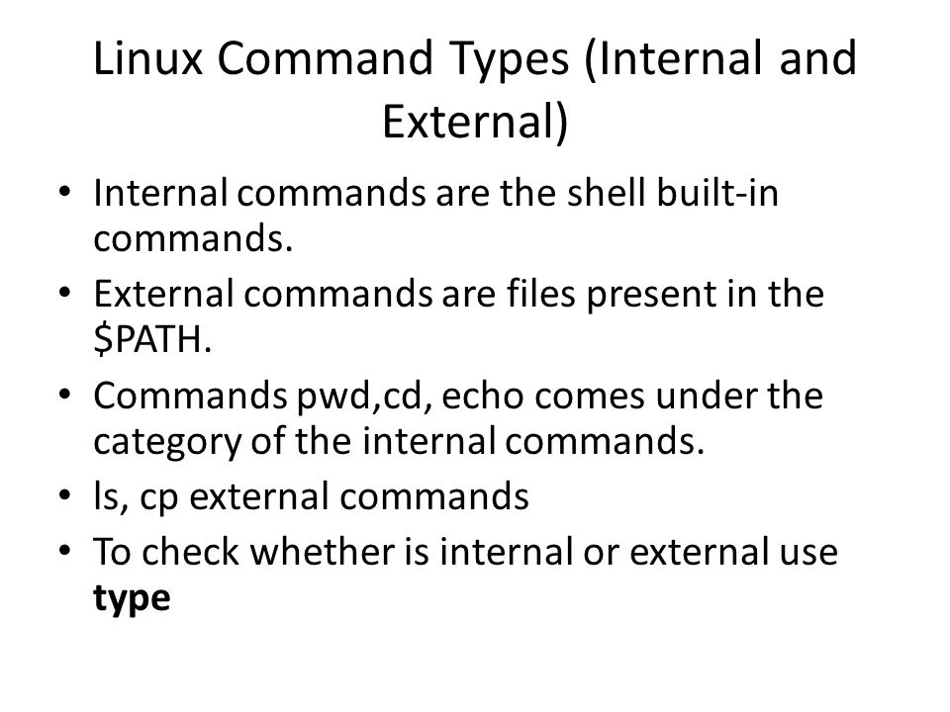

Slide 49
Type command
To find out whether a command given to the shell will be executed as an external command or as a builtin command, use the type command.
Example :
type cd
cd is a shell builtin
type cat
cat is /bin/cat
As you can see, the cd command is builtin and the cat command is external.

Slide 50
running external commands
Some commands have both builtin and external versions. When one of these commands is executed, the builtin version takes priority. To run the external version, you must enter the full path to the command.
$ type -a echo
echo is a shell builtin
echo is /bin/echo
$ /bin/echo Running the external

Slide 51
Which Command
The which command will search for binaries in the $PATH environment variable (variables will be explained later). In the following, it is determined that cd is builtin, and ls,
cp, rm, mv, mkdir, pwd, and which are external commands.
# which cp ls cd mkdir pwd
/bin/cp
/bin/ls
/usr/bin/which: no cd in (/usr/kerberos/sbin:/usr/kerberos/bin:...
/bin/mkdir
/bin/pwd

Slide 52
aliases
In Linux, an alias is a shortcut that references a command. An alias replaces a string that invokes a command in the Linux shell with another user-defined string.
Aliases are mostly used to replace long commands, improving efficiency and avoiding potential spelling errors. Aliases can also replace commands with additional options, making them easier to use.
alias c='clear‘
alias move='mv -i'
alias frename='Example/Test/file_rename.sh'

Slide 53
aliases
abbreviate commands
An alias can also be useful to abbreviate an existing command.
$ alias ll='ls -a'
$ alias c='clear'

Slide 54
alias :default options
Aliases can be used to supply commands with default options. The example below shows how to set the -i option default when typing rm.
$ alias rm='rm -i'
$ rm winter.txt
rm: remove regular empty file `winter.txt'? No

Slide 55
unalias
You can undo an alias with the unalias command.
$ which rm
/bin/rm
$ alias rm='rm -i'
$ which rm
alias rm='rm -i'
/bin/rm
$ unalias rm
$ which rm
/bin/rm

